Slide 1


Industrial Control with Knowledge Graphs
Internship period : 27th April to 31st August
Defence By Sivaratnam PACHAVA
M1 – CPS2
Internship Supervisor:
Victor CHARPENAY
associate professor in Computer Science, Mines Saint Etienne.
Academic Supervisor:
Pierre Maret
Professor in Computer Science, Université Jean Monnet,Saint Etienne.

Slide 2
Contents
Objective
Usecase Scenario
Architecture
Ontologies
Thing Description
Results

Slide 3
Objective
SIRAM project (Integrated Systems for Mobile Assistant Robots), a regional project involving Mecaconcept, Creative’IT and Mines Saint- ́Etienne is to develop an interoperable, adaptive information system that integrates mobile assistant robots (RAM) in the Industry 4.0 environment of IT’m Factory.
The goal is to develop a knowledge graph that describes the data and actions of the entities involved in industrial processes.

Slide 4
Knowledge Graph
KG’s can semantically interrelate many entities of different types for data analysis.
KG’s are particular kinds of databases designed to capture knowledge from various sources, represented as a set of interlinked entities.
It represents a collection of entities that are described with interlinked properties, objects, events, or concepts.

Slide 5
Usecase Scenario
The application scenario that we are use in this challenge is a manufacturing product line in the Industry 4.0 for filling and packaging yogurt.
The factory has different kinds of workshops which have different functions.
Conveying workshop
Filling workshop
Potting workshop
Packaging workshop

Slide 6
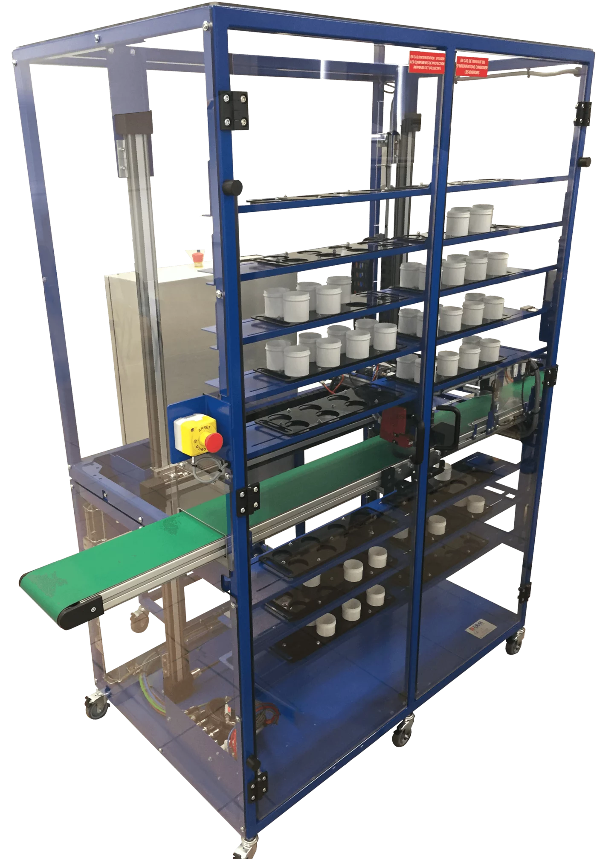
Conveying workshop (VL10)
It has a storage rack, a Cartesian robot on axes X/Z and a conveyor belt.
Used to pass empty cups to the next workshop via the conveyor.

Slide 7
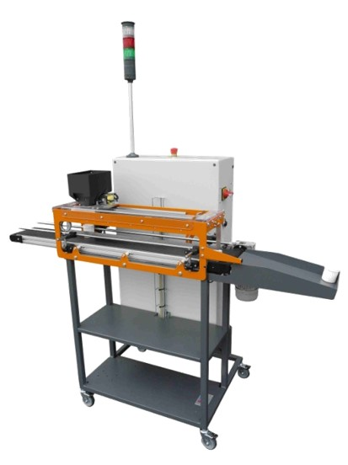
Filling workshop (DX10)
It has a Cartesian robot on axis X, a filler with a magnetic valve attached to the Cartesian robot and a conveyor belt.
It is used to fill containers on-the-fly while containers move towards the next workshop via the conveyor.

Slide 8
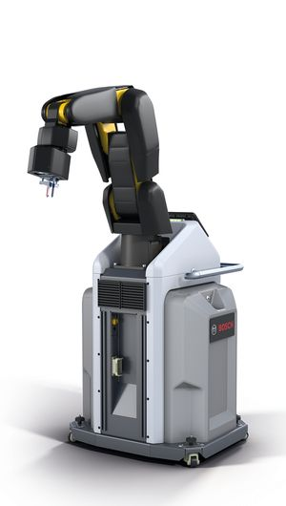
Potting workshop
We use a robotic arm and it has six degrees of freedom and a camera to control grasping/releasing.
The model we are using in our factory is Bosch APAS.

Slide 9
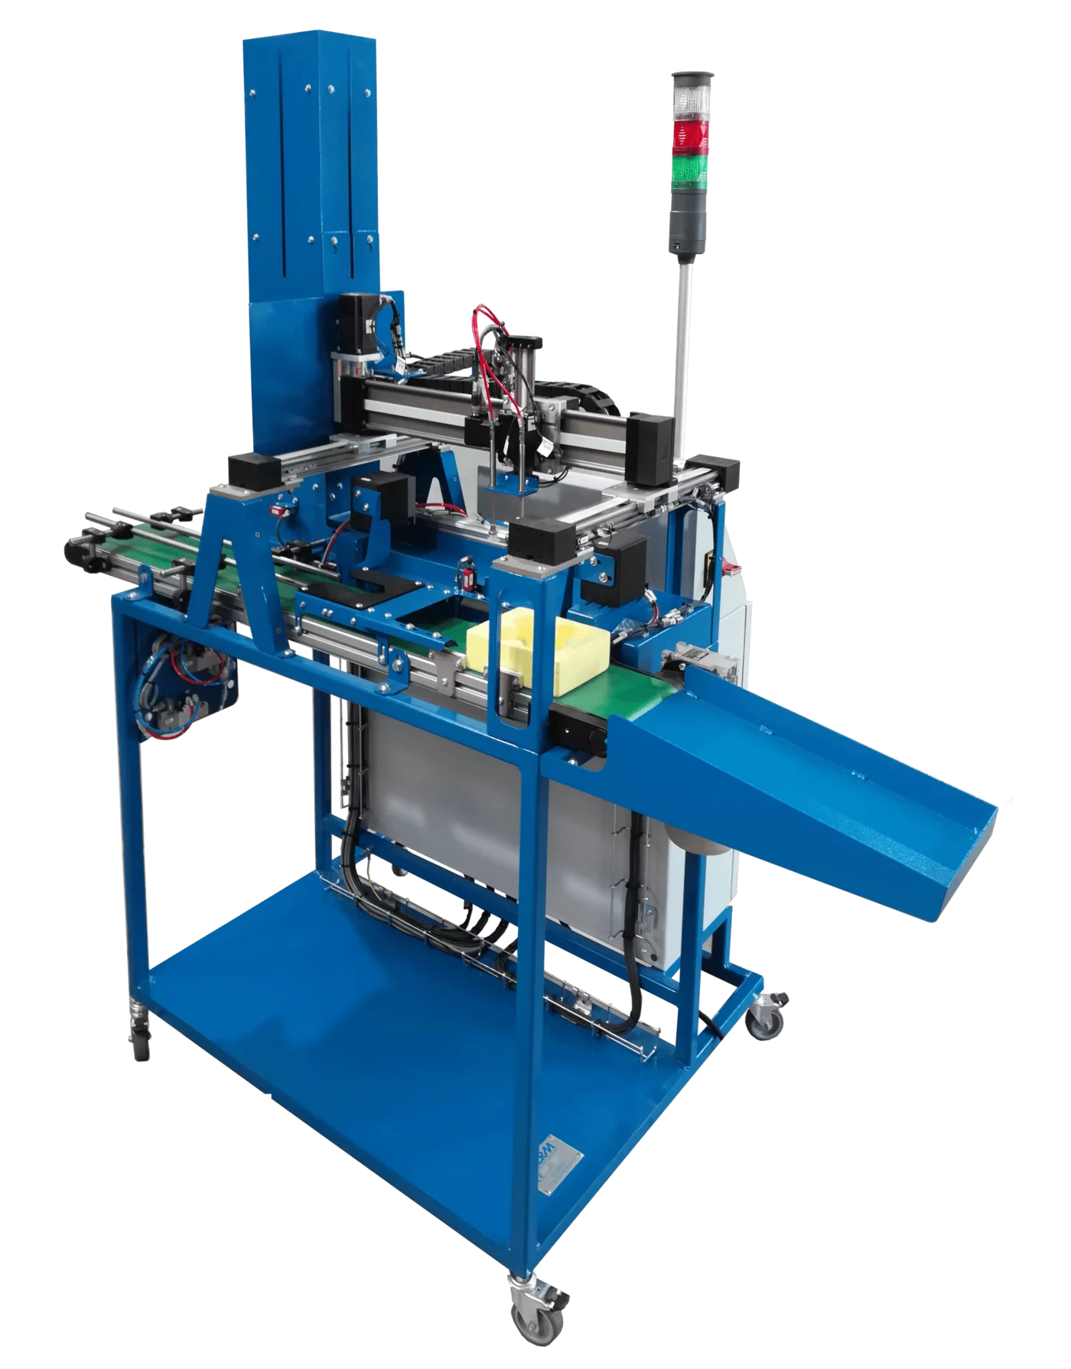
Packaging workshop (XY10)
It has a Cartesian robot on axes X/Y, a package buffer (stack) and two conveyor belts.

Slide 10
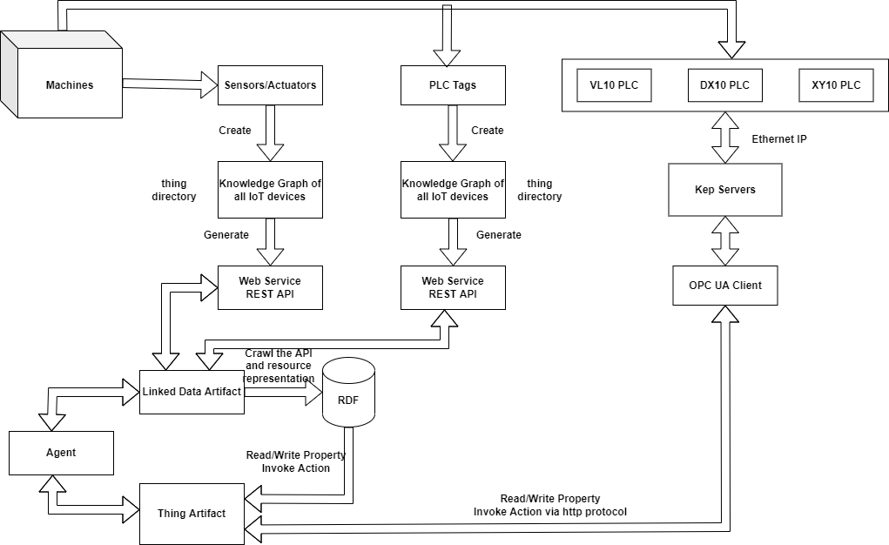
Architecture

Slide 11
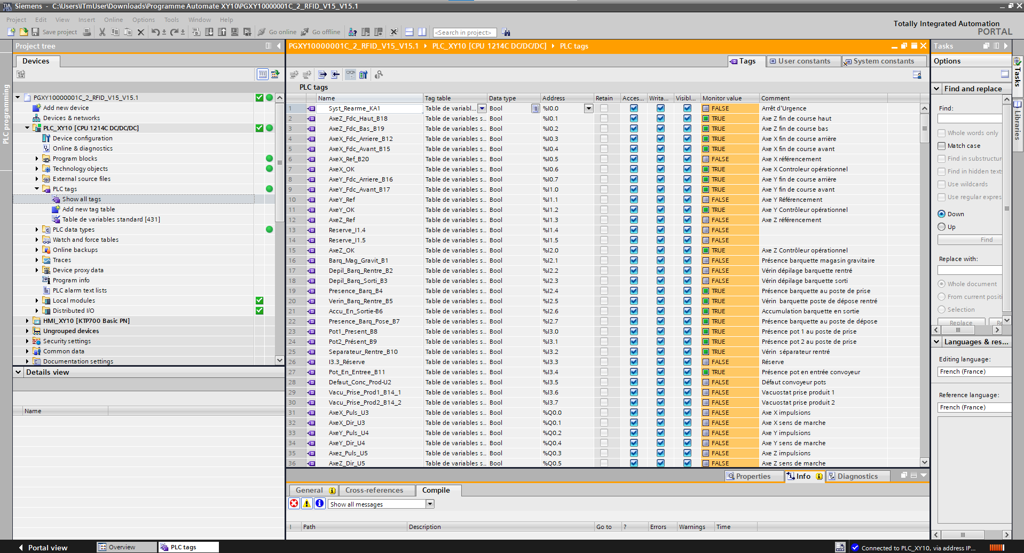
PLC Tags (Programmable Logic Controller)
PLC Tags are used to read real time values from the machines.
Every Tag has unique Logical Address.

Slide 12
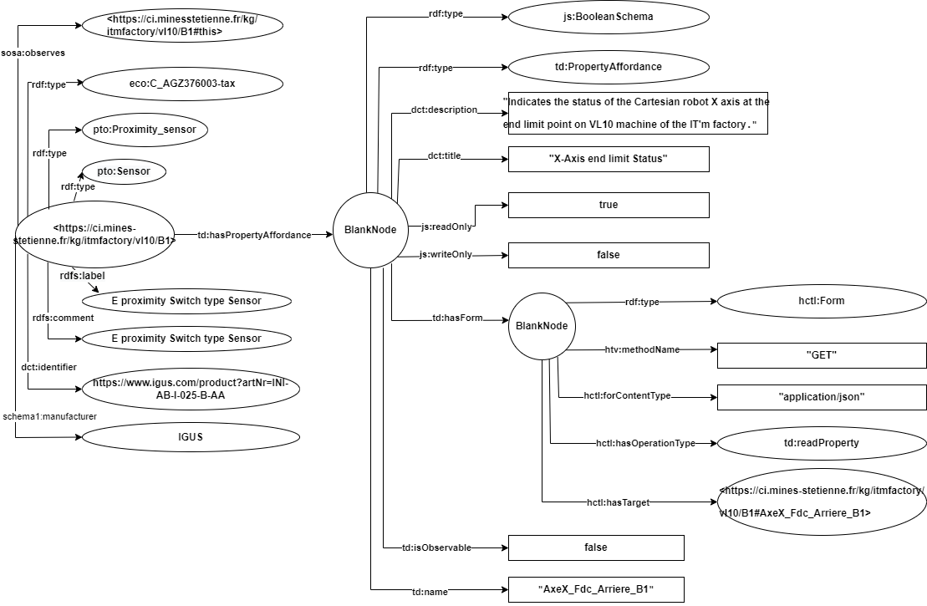
Ontologies
RDF
SOSA
PTO
DCMI
Schema
TD

Slide 13
Thing Description
The W3C Thing Description standard is a data model for WoT Things. It has four main components to describe TD instance.
Interaction Affordances
Property Affordance
Action Affordance
Event Affordance
Security Definations
Hypermedia Controls Vocabulary Definitions
Data Schema
Array Schema
Boolean Schema
Number Schema
String Schema
IntegerSchema
ObjectSchema
NullSchema

Slide 14
Namespace IRI
Each vocabulary used in the TD information model has its own namespace IRI. The vocabularies are independent from each other.
For representing core vocabulary -
https://www.w3.org/2019/wot/td#
For Data Schema -
https://www.w3.org/2019/wot/json-schema#
For Security Definitions -
https://www.w3.org/2019/wot/security#
For Hypermedia Controls –
https://www.w3.org/2019/wot/hypermedia#

Slide 15
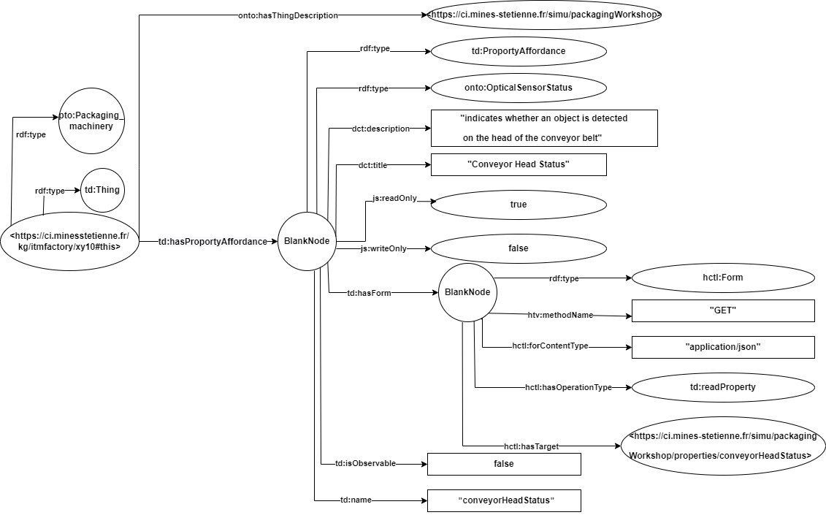
Proporty Affordance (Read Proporty)

Slide 16
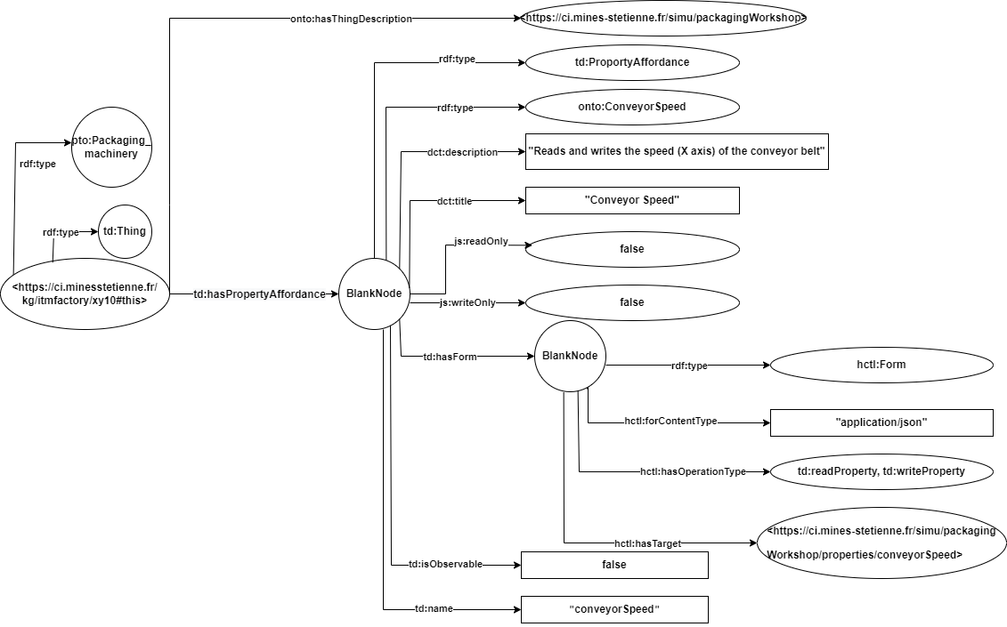
Proporty Affordance (Write Proporty)

Slide 17
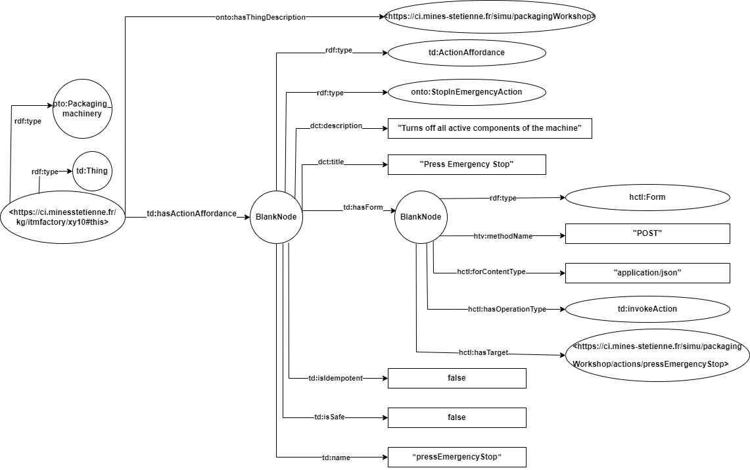
Action Affordance (Invoke Action)

Slide 18
Mounted Equipment

Slide 19
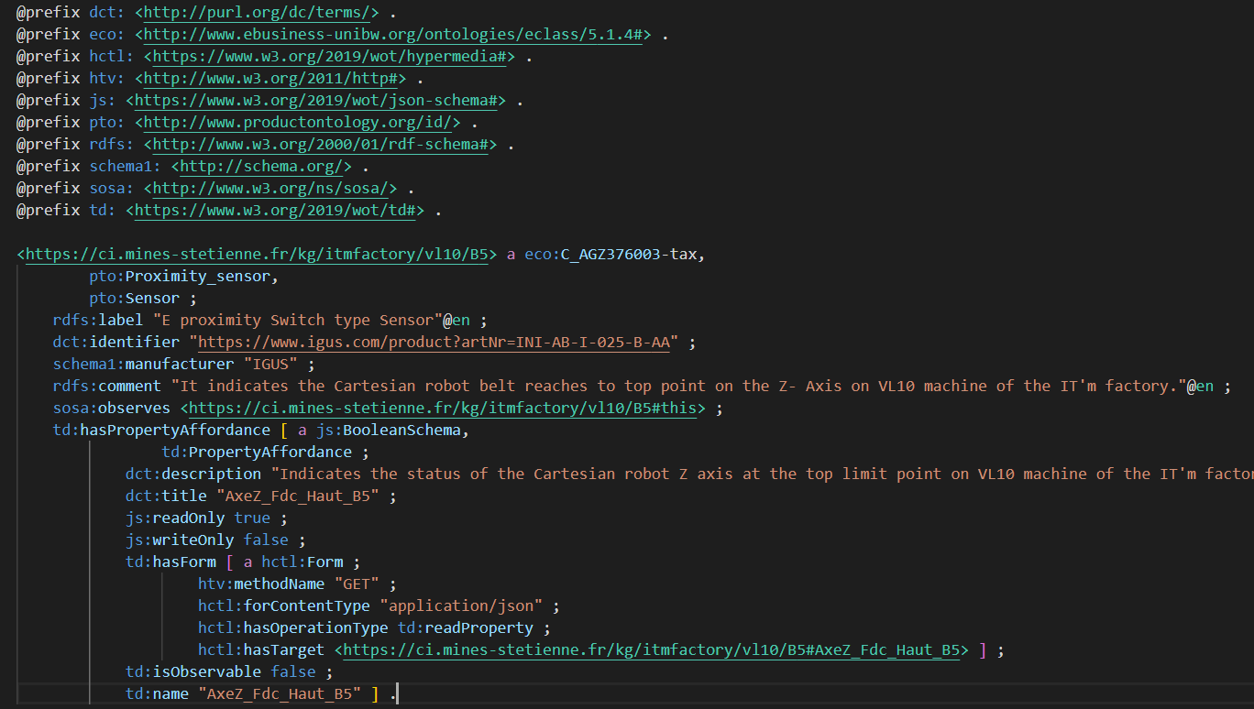
Example for Graph

Slide 20
URL’s for Graphs
For VL10 - http://127.0.0.1:5000/vl10
For DX10 - http://127.0.0.1:5000/dx10
For XY10 - http://127.0.0.1:5000/xy10

Slide 21
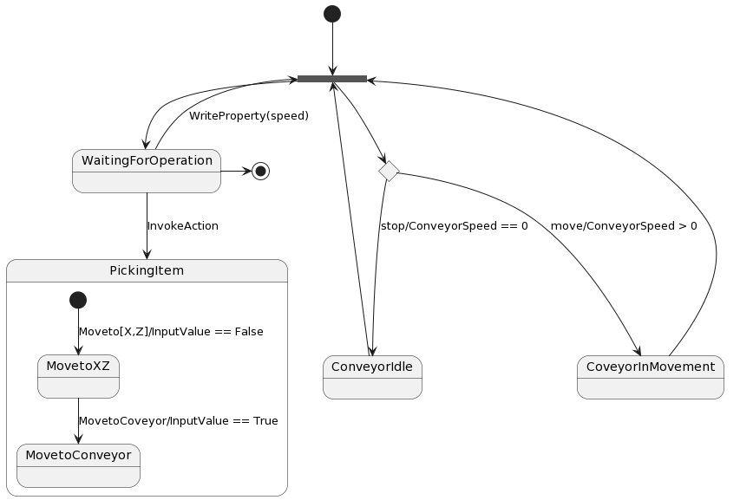
State Diagrams
I used PlantUML to draw state diagrams.
VL10:

Slide 22
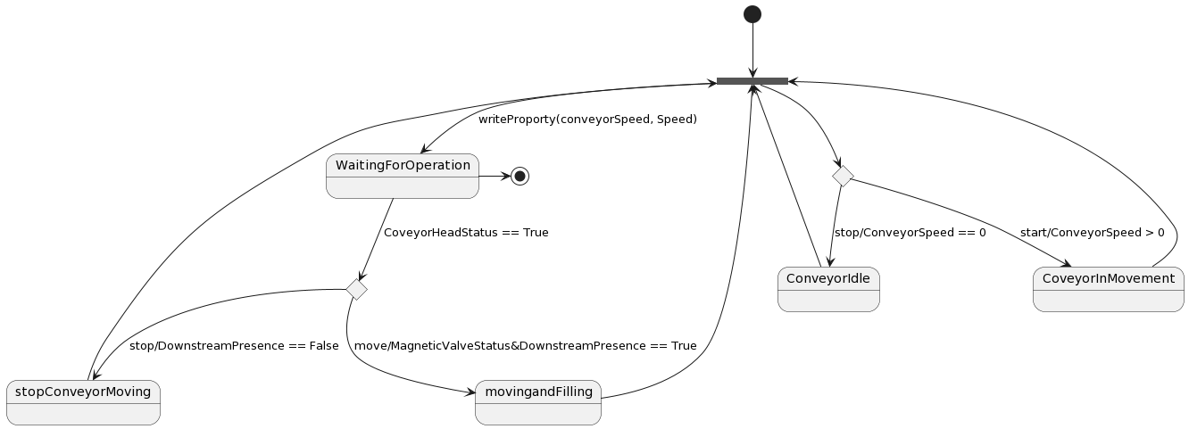
DX10:

Slide 23
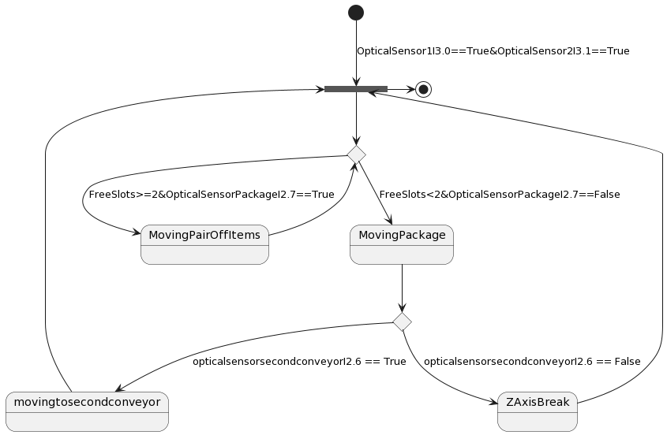
XY10:

Slide 24


